Slide 1
Chapter 12
How to work with cookies and sessions

Slide 2
Objectives
Applied
Use any of the functions and techniques presented in this chapter as you use cookies and session tracking in your applications.
Knowledge
Describe the use of cookies, and distinguish between session and persistent cookies.
Describe the use of session tracking.
Describe the use of the $_COOKIE and $_SESSION variables.
Describe the use of the functions for working with cookies and sessions.

Slide 3
Examples of cookies
PHPSESSID=D1F15245171203E8670487F020544490
user_id=87
email=jsmith@hotmail.com

Slide 4
How cookies work
A cookie is a name/value pair that is stored in a browser.
On the server, a web application creates a cookie and sends it to the browser.
On the client, the browser saves the cookie and sends it back to the server every time it accesses a page from that server.
By default, cookies only last until the user closes his or her web browser. However, cookies can be set to persist in the user’s browser until a specified expiration date.
Some users disable cookies in their browsers.
Browsers generally accept only 20 cookies from each site and 300 cookies total.
Browsers can also limit each cookie to 4 kilobytes.
A cookie can be associated with one or more subdomain names.

Slide 5
The syntax of the setcookie() function
setcookie($name, $value, $expire, $path,
$domain, $secure, $httponly)
Setting a cookie in the browser
$name = 'userid';
$value = '87';
$expire = strtotime('+1 year');
$path = '/';
setcookie($name, $value, $expire, $path);
Getting the value of a cookie from the browser
$userid = filter_input(INPUT_COOKIE, 'userid',
FILTER_VALIDATE_INT);
Deleting a cookie from the browser
$expire = strtotime('-1 year');
setcookie('userid', '', $expire, '/');

Slide 6
Key terms related to cookies
cookie
session cookie
persistent cookie

Slide 7
How to enable or disable cookies in Chrome 59
Open the Customize and control Google Chrome menu and select the Settings command.
Scroll down and click on the “Advanced.” link.
In the Privacy and security section, click on the “Content settings” link.
Click on the Cookies link.
Turn the “Allow sites to save and read cookie data” option on to enable cookies or off to disable cookies.

Slide 8
How to enable or disable cookies in IE 11
Open the Tools menu and select the Internet Options command.
Click the Privacy tab.
Use the slider control to enable or disable cookies, or click on the Advanced button, check the “Override automatic cookie handling” checkbox, configure cookies, and click the OK button.
To undo changes made with the slider control or in the Advanced section, click the Default button to return to default privacy settings.

Slide 9
How to reset default security settings in IE 11
Open the Tools menu and select the Internet Options command.
Click the Security tab.
If not disabled, click the “Reset all zones to default level” button.

Slide 10
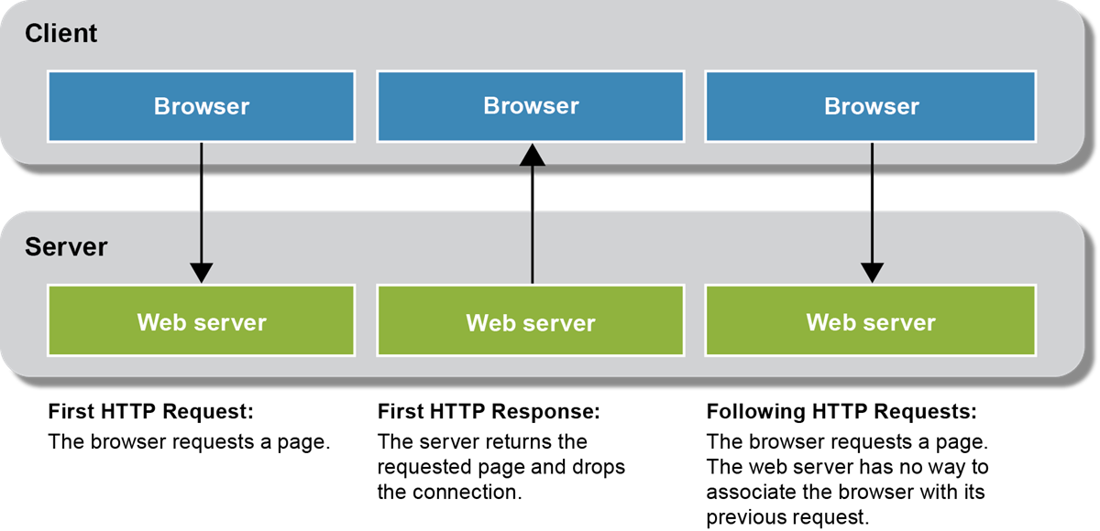
Why session tracking is difficult with HTTP

Slide 11
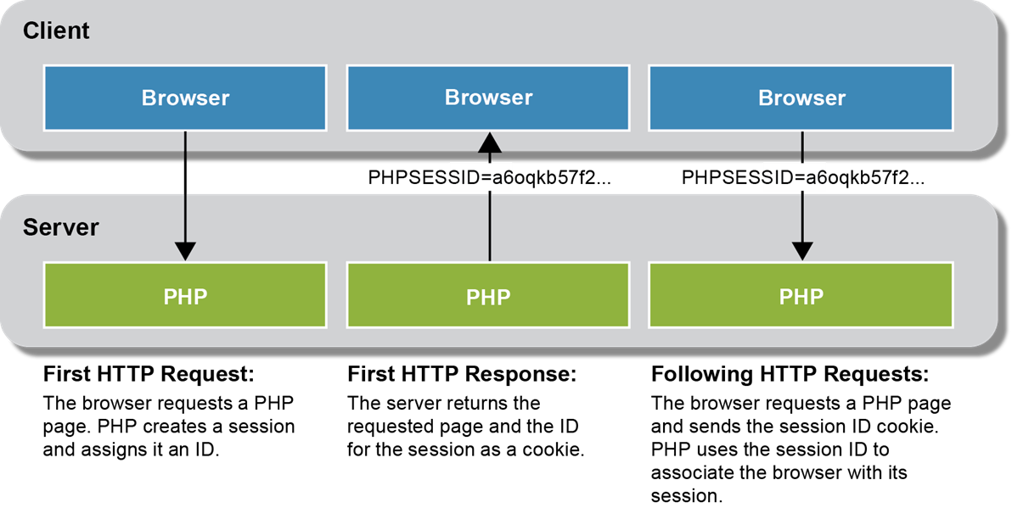
How PHP keeps track of sessions

Slide 12
Key terms related to session tracking
State
Stateless protocol
Session tracking
URL encoding

Slide 13
A function to start a session
session_start()
Start a session with the default cookie parameters
session_start();

Slide 14
The session_set_cookie_params() function
session_set_cookie_params($lifetime, $path, $domain,
$secure, $httponly)
Start a session with custom cookie parameters
$lifetime = 60 * 60 * 24 * 365; // 1 year in seconds
session_set_cookie_params($lifetime, '/');
session_start();

Slide 15
How to set and get scalar variables
Set a variable in a session
$_SESSION['product_code'] = 'MBT-1753';
Get a variable from a session
$product_code = $_SESSION['product_code'];

Slide 16
How to set and get arrays
Set an array in a session
if (!isset($_SESSION['cart'])) {
$_SESSION['cart'] = array();
}
Add an element to an array that’s stored in a session
$_SESSION['cart']['key1'] = 'value1';
$_SESSION['cart']['key2'] = 'value2';
Get and use an array that’s stored in a session
$cart = $_SESSION['cart'];
foreach ($cart as $item) {
echo '<li>' . $item . '</li>';
}

Slide 17
How to remove variables from a session
Remove a session variable
unset($_SESSION['cart']);
Remove all session variables
$_SESSION = array();

Slide 18
Functions to manage sessions
session_name()
session_id([$id])
session_write_close()
session_regenerate_id()
Get the name of the session cookie
$name = session_name(); // By default, PHPSESSID
Get the value of the session ID
$id = session_id();
Set the session ID
session_id('abc123');

Slide 19
A function to end a session
session_destroy()
End a session
$_SESSION = array(); // Clear session data from memory
session_destroy(); // Clean up the session ID

Slide 20
Delete the session cookie from the browser
// Get name of session cookie
$name = session_name();
// Create expire date in past
$expire = strtotime('-1 year');
// Get session params
$params = session_get_cookie_params();
$path = $params['path'];
$domain = $params['domain'];
$secure = $params['secure'];
$httponly = $params['httponly'];
setcookie($name, '', $expire, $path, $domain,
$secure, $httponly);

Slide 21
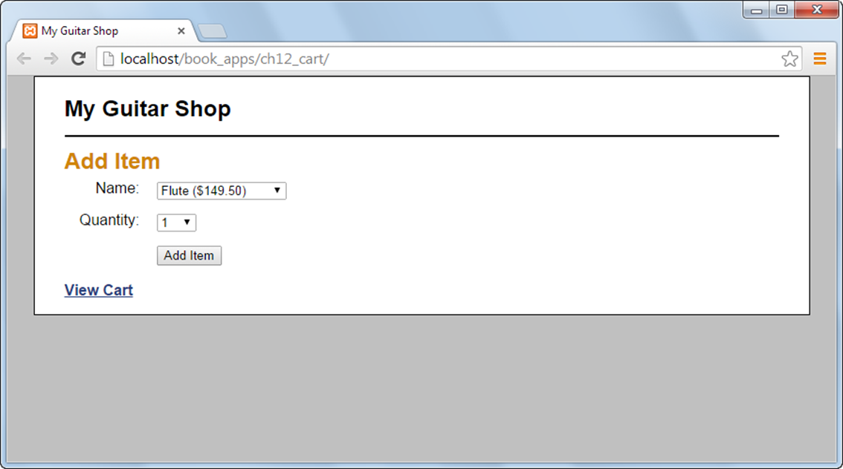
The Add Item page

Slide 22
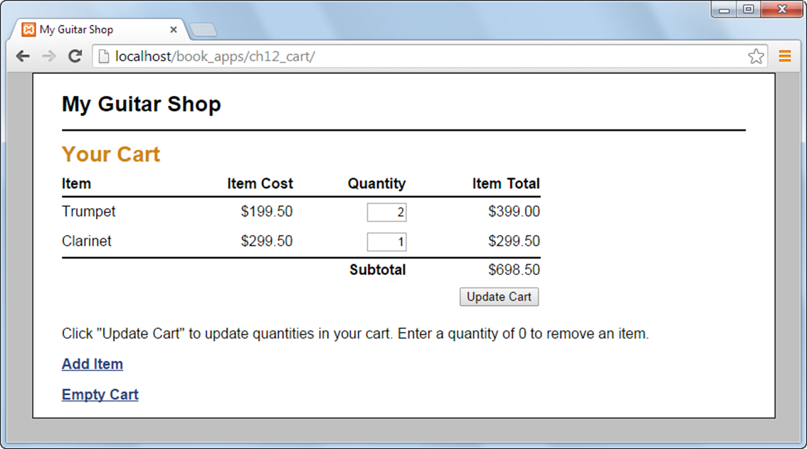
The Cart page

Slide 23
The index.php file (part 1)
<?php
// Start session management with a persistent cookie
$lifetime = 60 * 60 * 24 * 14; // 2 weeks in seconds
session_set_cookie_params($lifetime, '/');
session_start();
// Create a cart array if needed
if (empty($_SESSION['cart12'])) { $_SESSION['cart12'] =
array(); }
// Create a table of products
$products = array();
$products['MMS-1754'] =
array('name' => 'Flute', 'cost' => '149.50');
$products['MMS-6289'] =
array('name' => 'Trumpet', 'cost' => '199.50');
$products['MMS-3408'] =
array('name' => 'Clarinet', 'cost' => '299.50');

Slide 24
The index.php file (part 2)
// Include cart functions
require_once('cart.php');
// Get the action to perform
$action = filter_input(INPUT_POST, 'action');
if ($action === NULL) {
$action = filter_input(INPUT_GET, 'action');
if ($action === NULL) {
$action = 'show_add_item';
}
}
// Add or update cart as needed
switch($action) {
case 'add':
$product_key = filter_input(INPUT_POST,
'productkey');
$item_qty = filter_input(INPUT_POST, 'itemqty');
add_item($product_key, $item_qty);
include('cart_view.php');
break;

Slide 25
The index.php file (part 3)
case 'update':
$new_qty_list = filter_input(INPUT_POST, 'newqty',
FILTER_DEFAULT, FILTER_REQUIRE_ARRAY);
foreach($new_qty_list as $key => $qty) {
if ($_SESSION['cart12'][$key]['qty'] != $qty) {
update_item($key, $qty);
}
}
include('cart_view.php');
break;
case 'show_cart':
include('cart_view.php');
break;
case 'show_add_item':
include('add_item_view.php');
break;
case 'empty_cart':
unset($_SESSION['cart12']);
include('cart_view.php');
break;
}

Slide 26
The cart.php file (part 1)
<?php
// Add an item to the cart
function add_item($key, $quantity) {
global $products;
if ($quantity < 1) return;
// If item already exists in cart, update quantity
if (isset($_SESSION['cart12'][$key])) {
$quantity += $_SESSION['cart12'][$key]['qty'];
update_item($key, $quantity);
return;
}

Slide 27
The cart.php file (part 2)
// Add item
$cost = $products[$key]['cost'];
$total = $cost * $quantity;
$item = array(
'name' => $products[$key]['name'],
'cost' => $cost,
'qty' => $quantity,
'total' => $total
);
$_SESSION['cart12'][$key] = $item;
}

Slide 28
The cart.php file (part 3)
// Update an item in the cart
function update_item($key, $quantity) {
$quantity = (int) $quantity;
if (isset($_SESSION['cart12'][$key])) {
if ($quantity <= 0) {
unset($_SESSION['cart12'][$key]);
} else {
$_SESSION['cart12'][$key]['qty'] = $quantity;
$total = $_SESSION['cart12'][$key]['cost'] *
$_SESSION['cart12'][$key]['qty'];
$_SESSION['cart12'][$key]['total'] = $total;
}
}
}

Slide 29
The cart.php file (part 4)
// Get cart subtotal
function get_subtotal() {
$subtotal = 0;
foreach ($_SESSION['cart12'] as $item) {
$subtotal += $item['total'];
}
$subtotal_f = number_format($subtotal, 2);
return $subtotal_f;
}
?>

Slide 30
The add_item_view.php file (part 1)
<!DOCTYPE html>
<html>
<head>
<title>My Guitar Shop</title>
<link rel="stylesheet" type="text/css" href="main.css">
</head>
<body>
<header>
<h1>My Guitar Shop</h1>
</header>
<main>

Slide 31
The add_item_view.php file (part 2)
<h1>Add Item</h1>
<form action="." method="post">
<input type="hidden" name="action" value="add">
<label>Name:</label>
<select name="productkey">
<?php foreach($products as $key => $product) :
$cost = number_format($product['cost'], 2);
$name = $product['name'];
$item = $name . ' ($' . $cost . ')';
?>
<option value="<?php echo $key; ?>">
<?php echo $item; ?>
</option>
<?php endforeach; ?>
</select><br>

Slide 32
The add_item_view.php file (part 3)
<label>Quantity:</label>
<select name="itemqty">
<?php for($i = 1; $i <= 10; $i++) : ?>
<option value="<?php echo $i; ?>">
<?php echo $i; ?>
</option>
<?php endfor; ?>
</select><br>
<label>&nbsp;</label>
<input type="submit" value="Add Item">
</form>
<p><a href=".?action=show_cart">View Cart</a></p>
</main>
</body>
</html>

Slide 33
The cart_view.php file (part 1)
<!DOCTYPE html>
<html>
<head>
<title>My Guitar Shop</title>
<link rel="stylesheet" type="text/css" href="main.css">
</head>
<body>
<header>
<h1>My Guitar Shop</h1>
</header>
<main>

Slide 34
The cart_view.php file (part 2)
<h1>Your Cart</h1>
<?php if (empty($_SESSION['cart12']) ||
count($_SESSION['cart12']) == 0) : ?>
<p>There are no items in your cart.</p>
<?php else: ?>
<form action="." method="post">
<input type="hidden" name="action"
value="update">
<table>
<tr id="cart_header">
<th class="left">Item</th>
<th class="right">Item Cost</th>
<th class="right">Quantity</th>
<th class="right">Item Total</th>
</tr>

Slide 35
The cart_view.php file (part 3)
<?php foreach(
$_SESSION['cart12'] as $key => $item ) :
$cost = number_format($item['cost'], 2);
$total = number_format($item['total'], 2);
?>
<tr><td><?php echo $item['name']; ?> </td>
<td class="right">
$<?php echo $cost; ?> </td>
<td class="right">
<input type="text" class="cart_qty"
name="newqty[<?php
echo $key; ?>]"
value="<?php
echo $item['qty']; ?>"></td>
<td class="right">
$<?php echo $total; ?></td>
</tr>
<?php endforeach; ?>

Slide 36
The cart_view.php file (part 4)
<tr id="cart_footer">
<td colspan="3"><b>Subtotal</b></td>
<td>$<?php echo get_subtotal(); ?></td>
</tr>
<tr>
<td colspan="4" class="right">
<input type="submit"
value="Update Cart"></td>
</tr>
</table>
<p>Click "Update Cart" to update quantities in
your cart. Enter a quantity of 0 to remove
an item.</p>
</form>
<?php endif; ?>
<p><a href=".?action=show_add_item">Add Item</a></p>
<p><a href=".?action=empty_cart">Empty Cart</a></p>
</main>
</body>
</html>

